Slide 1
Chapter 2
1
Synchronization

Slide 2
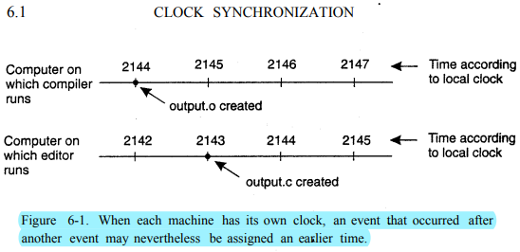
Synchronization
2
Definition of CLOCK SYNCHRONIZATION: A technology allowing the clocks to receive time data and display accurate and uniform time throughout the distributed system
How do Synchronized clocks are used?
In many types of facilities for the purpose of having all clocks in the facility show the exact same time.

Slide 3
Physical Clocks
2
Definition of Physical Clock: It is a computer timer which is a precisely machine quartz crystal. For example, processor local time.

Slide 4
Physical Clocks issue
2
P1
m
P2
P1 is a processor in Riyadh
P2 is a processor in New York
P1 sends a message m at 10 pm (Riyad local time) and P2 receives the message m at 1.30 pm (New York local time). So, it seems that the message m is received before it is sent as a result of physical time difference.

Slide 5
Physical Clocks issue
2
Clock Synchronization Algorithms are used to solve physical clock synchronization issue, which are:
1- Network Time Protocol
2- Berkeley's Algorithm

Slide 6

Clock Synchronization Algorithms for Physical Clocks 1-Network Time Protocol
3
Clock Synchronization Algorithms are used to solve physical clock synchronization issue
1- Network Time Protocol (): Proposed by Cristian, it is common protocol that lets clients contact time server , latter can provide current time .
- Formula to calculate propagation delays:
Definition of Network Time Protocol (NTP): is a protocol that allows the synchronization of system clocks (from desktops to servers)

Slide 7
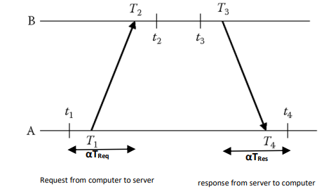
Clock Synchronization Algorithms for Physical Clocks 1-Network Time Protocol
3
- Formula to calculate propagation delays:
Definition of Network Time Protocol (NTP): is a protocol that allows the synchronization of system clocks (from desktops to servers)

Slide 8
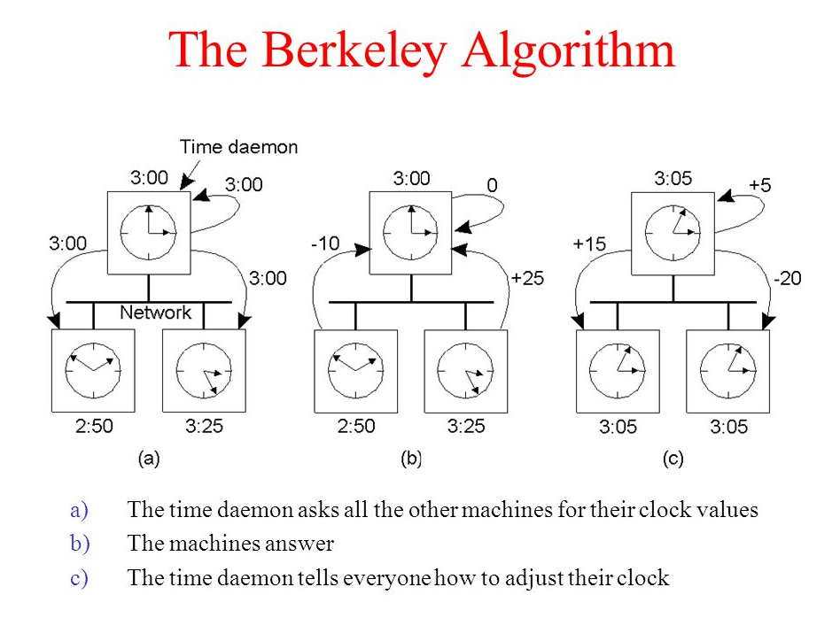
Clock Synchronization Algorithms for Physical Clocks 2- Berkeley Algorithm
4
How does Berkeley algorithm work?
Berkeley's Algorithm is a clock synchronization technique used in distributed systems. The algorithm assumes that each machine node in the network either doesn't have an accurate time source or doesn't possess a UTC server.
An individual node is chosen as the master node from a pool node in the network. The it coordinates to adjust the time of all computers.

Slide 9
LOGICAL CLOCKS
5
LOGICAL CLOCKS: is a mechanism for capturing chronological as every processer counts its events starting from zero
P1
1 2 3
m
P2
1 2
P1 is a processor has 3 events
P2 is a processor has 2
P1 sends a message m at 2 (P1 logical time, since it is the second event in P1) and P2 receives the message m at 1 (P2 logical time, since it is the first event in P2). So it seems that the message m is received before it is sent as a result of logical time difference.

Slide 10
LOGICAL CLOCKS
5
To solve logical time issue we use:
1- Lamport’s Logical Clocks
2- Vector Logical Clock
How Lamport’s Work?
Its defined a relation called happened before , its shown as a ~ b is read “a happens before b”.
It has two situations :
1- If a and b are events in same process , and a occur before b , then a ~ b is true.
2- If a is event of a message and sent by one process , and b received the message by another process also a ~ b is true.

Slide 11
Lamport’s Logical Clocks
6
Lamport’s logical Clock
1- Processor time T start at 0.
2- if the events are in the same processor, then the new T = current T +1
3- if the events are in more than one processor such as a message passing, then if P1 send a message to P2:
P1 attaches its local time to the message
When P2 receives the message it compares the P1 T that comes with the message with its own T, and considers the greatest, then the new T = max(P1(T), P(T)) + 1

Slide 12
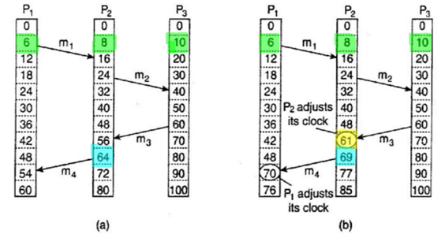
Lamport’s Logical Clocks
6
How Lamport’s logical Clock works? Illustrate with 3 processors
In Figure (a), the logical time in the three processors start at 0, then P1 has 5 events and in event 6 it sends m1 to P2 (when P1 has time (event) 6, p2 has 8 events and P3 has 10). P2 receives m1 at 16 and at 24 P2 sends m2 to P3. P3 receives m2 at 40 and at 60 P3 sends m3 to P2. P2 receives m3 at 56 (It seems that P2 receives the m3 before P3 sends it, because of the time differences) and at 64 P2 sends m4 to P1. P1 receives m4 at 54 (It seems that P1 receives the m4 before P2 sends it, because of the time differences) .

Slide 13
Lamport’s Logical Clocks
6
Lamport’s logical Clock
1- Proceesot time T start at 0.
2- if the events in the same processors
In Figure (b), shows how Lamport’s algorithm fixes the issue. The logical time in the three processors start at 0, then P1 has 5 events and in event 6 it sends m1 to P2 (when P1 has time (event) 6, p2 has 8 events and P3 has 10). P2 receives m1 at 16 and at 24, P2 sends m2 to P3. P3 receives m2 at 40 and at 60 P3 sends m3 to P2. P2 receives m3 at 56 but:
New T = max(P1(60), P(56)) + 1
New T = 60 +1 = 61
So p2 fixes its time to 61. Then at 69, P2 sends m4 to P1. P1 receives m4 at 54 but:
New T = max(P1(69), P(54)) + 1
New T = 69 +1 = 70
So p2 fixes its time to 70.

Slide 14
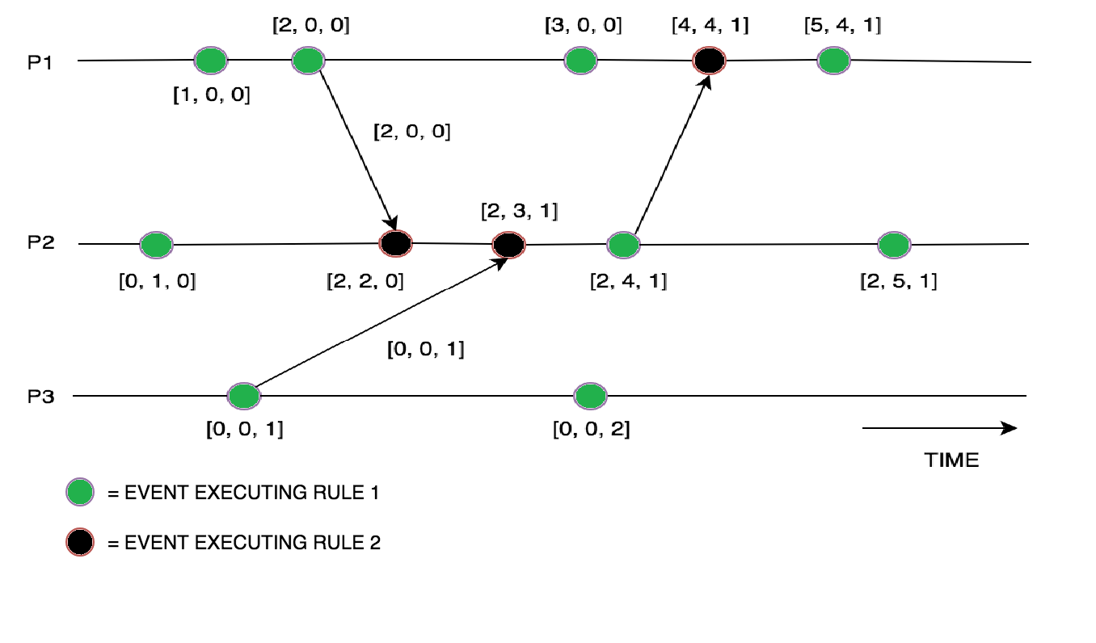
Vector Logical Clock
7
Having 3 processors the vector time has 3 parameters which are the logical time of each processors T =[P1(T), P2(T), P3(T)], at the beginning the T [0,0,0], then:
P2 has an event so P2.T[0, 1, 0]
P1 has an event so P1.T[1, 0, 0] not aware of P2 events
P3 has an event so P3.T[0, 0, 1] not aware of P1 & P2 events
P1 has an event so P1.T[2, 0, 0], it sends a m with its Time to P2
P2 has an event as it receives P1 message. So it updates it
parameter and P1 as well so P2.T[2,2,0] … and so on

Slide 15
Mutual Exclusion
8
Mutual exclusion: is a property of process no two processes can exist in the critical section at any given point of time
Types of Mutual Exclusion:
1- Token – Based
2- Permission – Based approach

Slide 16
Mutual Exclusion vs Permission
9
Token - Based
Achieved by passing special messages as Token
Permission – Based approach
Process waiting to access the resource , first it requires the permission of other process.
Token is only one , and who ever has it , he can reach to resource . after finished moved to the next process
1- Token helps to avoid starvation that mean ensuring easily by giving a chance to each process to access the resource.
2- Token helps to avoid deadlock when several processes are waiting for each other to proceed, can easily be avoided.
In Token based all processes should have Token , but in Permission they should have Permission

Slide 17
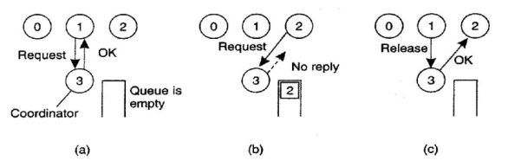
Centralized V.S. Decentralized Algorithm
10
Centralized Algorithm: One process selected as a coordinator , any other process want to access shared resource it has to send message to the coordinator stating which resource it wants to access and asking for permission , if no process is accessing that resource , the coordinator will send a reply permission.
Process 1 asks coordinator (3) for permission to access shared resource Queue.
Process 2 asks to access the same resource. coordinator doesn’t replay
When process 1 release the resource, it tells the coordinator to replay to process 2.

Slide 18
Centralized Algorithm Decentralized Algorithm
11
Decentralized Algorithm:
1- Each resource is assumed to be replicated n times. Every replica has its own coordinator for controlling the access by concurrent processes.
2- When a process wants to access the resource, it will need to get a vote of coordinators to access the recourse.

